Slide 1

Automotive Technology:
A Systems Approach, 8e
Chapter 11: Lower End Theory and Service
Rob Thompson and Jack Erjavec, Automotive Technology: A Systems Approach, 8th Edition. © 2025 Cengage. All Rights Reserved. May not be scanned, copied or duplicated, or posted to a publicly accessible website, in whole or in part.

Slide 2
Chapter Objectives (1 of 2)
11.01 Be able to disassemble and inspect an engine’s cylinder block.
11.02 Perform repairs to recondition an engine block.
11.03 List the parts that make up a short block and briefly describe their operation.
11.04 Inspect crankshafts, crankshaft dampers, and flywheels.
11.05 Explain the function of engine bearings, flywheels, and harmonic balancers.

Slide 3
Chapter Objectives (2 of 2)
11.06 Be able to perform the common service and assembly techniques used in connecting rod and piston servicing.
11.07 Be able to install pistons in their cylinder bores.
11.08 Inspect and install an OHV camshaft and bearings.
11.09 Install crankshaft and camshaft timing components and verify correct timing.
11.10 Inspect, service, and install an oil pump.

Slide 4
Short Block Disassembly (1 of 2)
11.01 Be able to disassemble and inspect an engine’s cylinder block.
In this sample procedure, the engine is on an engine stand, and the cylinder head(s) are removed from the cylinder block.
If the oil pan and water pump are still attached to the block, remove them before proceeding.
Remove the harmonic balancer, also called a vibration damper. A careful inspection should be performed. Once the balancer is removed, carefully check
the rubber for tears, separation of inner and outer sections, or other damage. If there are any faults, replace the balancer.
On OHV engines, remove the timing cover. Under the cover are the timing gears.
The crankshaft’s timing sprocket has a slight interference fit and can normally be pulled off by hand, as can the camshaft sprockets. The camshaft sprocket and chain must be removed with the crankshaft sprocket.

Slide 5
Short Block Disassembly (2 of 2)
Before removing the gears and chain, check the deflection of the timing chain.
  Depress the chain at its midway point between the gears and measure the amount that the chain can be deflected.
  If the deflection exceeds specifications, the timing chain and gears should be replaced. Loosen the camshaft sprocket and pull the timing gears and chain from the engine.
  Normally, the timing gear assembly is replaced during an engine overhaul, as are its tensioners and guides.
On some engines, the oil pump is driven by the crankshaft at the front of the engine.
If the lifters have not been removed, do so now. Place them on a bench in the order they were removed.
Carefully pull the camshaft out of the block. Support the camshaft to avoid dragging its lobes over the surfaces of the camshaft bearings. This can damage the bearings and lobes.

Slide 6
Cylinder Block Disassembly (1 of 3)
Rotate the engine on its stand so that the bottom is facing up.
Remove the oil pan if it was not previously removed, then remove the oil pump.
Be careful not to lose the drive shaft while pulling the pump off the engine.
If the engine has balance shafts, check the thrust clearance of the shafts before removing the assembly using a dial indicator and referencing specifications.
If the reading is more than the specified maximum, the balance shaft housing and bearings should be replaced.
Rotate the crankshaft to put a cylinder at BDC.
Carefully remove the cylinder ridge with a ridge reamer tool.
Remove just enough metal to allow the piston to slip out of the bore without causing damage to the bore. The ridge is formed at the top of the cylinder. Because the top ring stops traveling before it reaches the top of the cylinder, a ridge of unworn metal is left.

Slide 7
Cylinder Block Disassembly (2 of 3)
Check all connecting rods and main bearing caps for correct position and numbering. If the numbers are not visible, use a center punch or number stamp to number them.
To remove the piston and rod assemblies, position the throw of the crankshaft at the bottom of its stroke.
Remove the connecting rod nuts and cap. Remember that the caps and rods must remain as a set.
To help remove the cap, tap the cap lightly with a soft hammer or wood block carefully while protecting the critical surfaces.
Loosen and remove the main bearing cap bolts and main bearing caps.
After removing the main bearing caps, carefully remove the crankshaft then store the crankshaft in a vertical position to avoid damage.
Examine the bearings

Slide 8
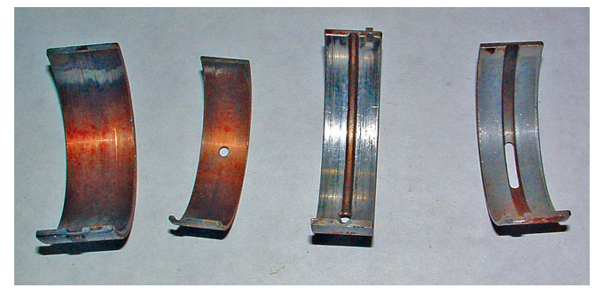
Cylinder Block Disassembly (3 of 3)
Inspect bearing inserts for signs of unusual wear, embedded metal particles, lack of lubrication, antifreeze contamination, oil dilution, and uneven wear.
Then carefully inspect the main journals on the crankshaft for damage.
Before removing the camshaft bearings, inspect the bearing surfaces for signs of scoring or other damage. Also note the location of where the oil holes are in relation to the block.
This is important for installing the new bearings correctly.
To remove the camshaft bearings on an OHV block, you will need a cam bearing tool.
Oil passageways must be inspected and cleaned.
Core plugs should be removed for later replacement.

Slide 9
Cylinder Block (1 of 2)
11.02 Perform repairs to recondition an engine block.
The cylinder blocks are normally a one-piece casting which may be cast from different materials such as iron, aluminum, magnesium, or possibly, in the future, plastic.
A few engine blocks have a magnesium exterior with cast-iron inserts to serve as cylinders, coolant passages, etc.
Some late-model blocks are made of two pieces: an upper unit that contains the cylinders and a lower one that surrounds the crankshaft.
Cast-iron blocks are very strong but heavy.
Many engines have an aluminum block to reduce the vehicle’s overall weight.
Certain materials are added to aluminum to make it stronger and less likely to warp from the heat of combustion.

Slide 10
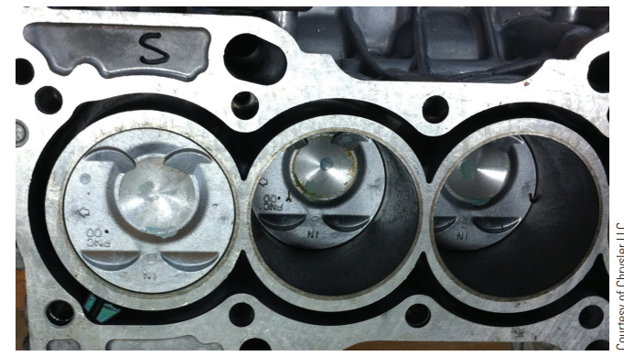
Cylinder Block (2 of 2)
Cylinder Liners
  The cylinder walls of aluminum blocks may be treated with a special coating or have a sleeve or liner to serve as cylinder walls.
  The liners are made of a cast-iron alloy.
  Most are very thin and cannot be serviced and the block must be replaced if the walls are damaged.
  The liners have ribs on their outside diameter.
    These ribs hold the liner in place and increase its ability to dissipate heat.

Slide 11
Knowledge Check (1 of 2)
  Why are modern engine blocks commonly made of aluminum?

Slide 12
Knowledge Check Answer (1 of 2)
  Answer: Many engines have an aluminum block to reduce the vehicle’s overall weight.

Slide 13
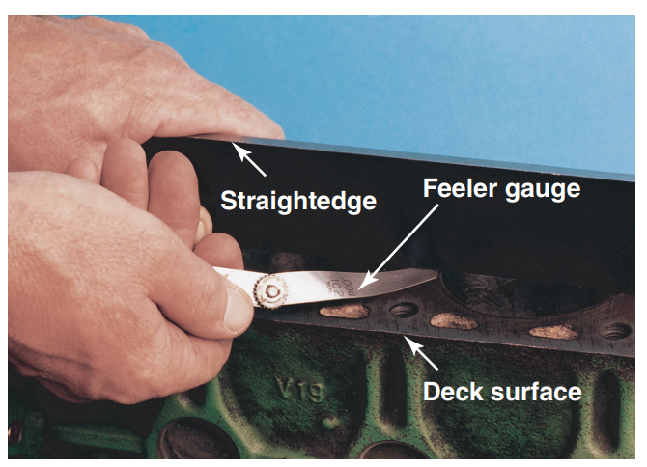
Cylinder Block Reconditioning
Deck Flatness
The top of the block is called the deck.
To check deck warpage, use a precision straightedge and feeler gauge.
With the straightedge positioned diagonally across the deck, the amount of warpage is determined by the size of the feeler gauge that fits into the gap between the deck and the straightedge.

Slide 14
Cylinder Bore Inspection
Inspect the cylinder walls for scoring, roughness, or other signs of wear.
Dirt can accelerate ring and cylinder wall wear.
If the cylinder walls show light scratches, inspect the air induction system for leaks. Unfiltered air can allow dirt to enter the cylinders and damage the walls.
Most cylinder wear occurs at the top of the ring travel because pressure on the top ring is at a peak and lubrication at a minimum when the piston is at the top of its stroke.
A ridge of unworn material builds above the upper limit of ring travel. Below the ring travel area, wear is negligible because only the piston skirt contacts the cylinder wall.
A cylinder should have the correct diameter, no taper or out-of-roundness, and the surface finish must be such that the piston rings will seat to form a seal that will control oil and minimize blowby.

Slide 15
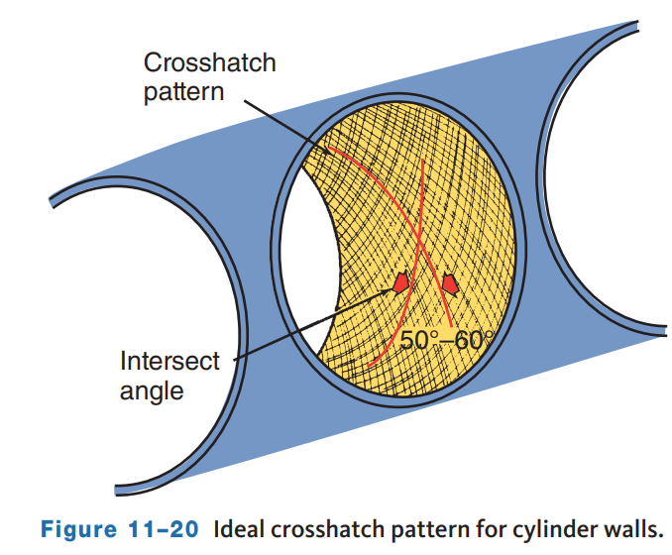
Cylinder Bore Surface Finish
The surface finish on a cylinder wall should act as an oil reservoir to lubricate the piston rings and prevent piston and ring scuffing.
Piston ring faces can be damaged and wear prematurely if the wall is too rough. A surface that is too smooth will not hold enough oil and scuffing may occur.
Ideally, these grooves cross at 50- to 60-degree angles, although anything from 20 to 60 degrees is acceptable.
This finish leaves millions of tiny diamond-shaped areas to serve as oil reservoirs.

Slide 16
Installing Core Plugs
Make sure the plugs are the correct size and type.
Coat the plug or bore lightly with a nonhardening oil-resistant (oil gallery) or water-resistant (cooling jacket) sealer.
If the threads for the oil plugs are damaged, run a tap through the bore.
If the bore for a core plug is damaged, it should be bored out for an oversized plug.
Oversize (OS) plugs are identified by the OS stamped on the plug.
The correct way to install a core plug depends on the type of plug. Disc- or Dished-Type.
These fit in a bore with the dished side facing out.
With a hammer, hit the center of the disc’s crown and drive the plug in until just the crown becomes flat. This expands the plug so that it can make a good seal.

Slide 17
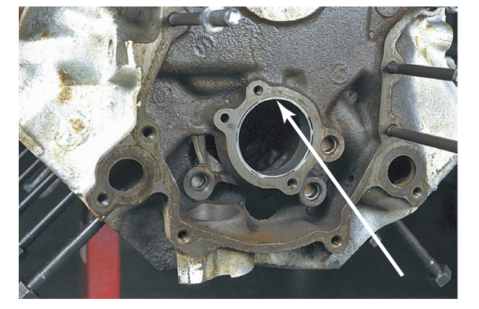
Camshaft Bearings
The camshaft is supported by several bearings, or bushings.
OHV camshaft bearings are one-piece plain bearings pressed into the camshaft bore.
Inspect the bearing bores for wear and out-of-roundness.
Use a bore gauge or telescoping gauge to measure the bore diameter vertically and horizontally with the block.

Slide 18
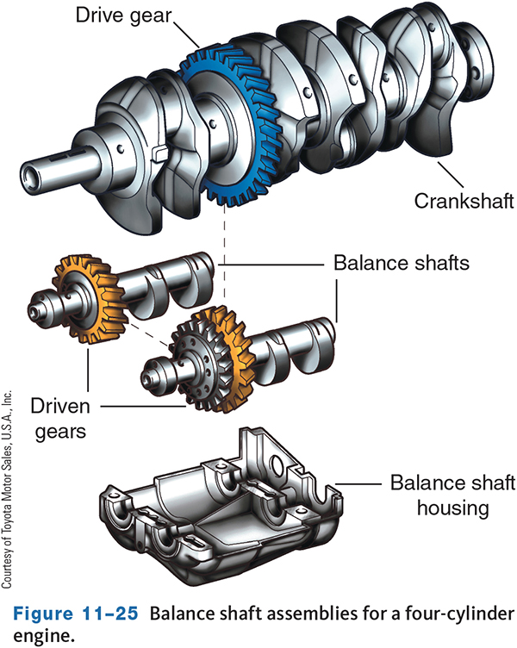
Balance Shafts
An engine’s crankshaft is one of the main sources of engine vibration because it is inherently out of balance. Balance shafts are designed to cancel out these vibrations.
A balance shaft has counterweights designed to mirror the throws of the crankshaft. These weights are positioned to the opposite side of the weight of the crankshaft and are rotated in the opposite direction as the crankshaft.
As the engine turns, the opposing weights cancel out any vibrations.
Balance shafts are timed to the rotation of the crankshaft and if timed incorrectly, the engine may vibrate more than it would without a balance shaft.

Slide 19
Crankshaft
11.04 Inspect crankshafts, crankshaft dampers, and flywheels.
Crankshafts are made of cast iron, forged cast steel, or nodular iron, and then machined.
At the centerline of the crankshaft are the main bearing journals.
These journals are machined to a very close tolerance because the weight and movement of the crankshaft are supported at these points.
A connecting rod journal is also called a crankpin.
The position of the rod journals places the weight and pressure from the pistons away from the center of the crankshaft which creates an imbalanced condition.
To overcome this imbalance, counterweights are built into the crankshaft to offset the weight of the pistons and connecting rods.
These are positioned opposite the connecting rod journals.
Some engines use flat-plane crankshafts.

Slide 20
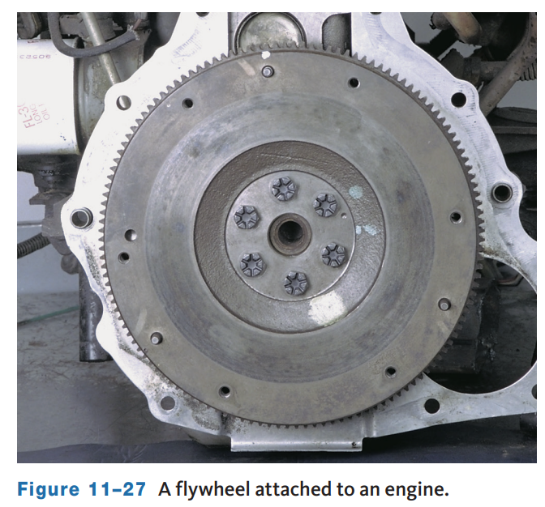
Flywheel
The flywheel helps the engine run smoother by applying a constant moving force to carry the crankshaft from one firing stroke to the next.
The large diameter supplies good gear reduction for the starter, making it easy for it to turn the engine against its compression.
The surface of a flywheel may be used as part of the clutch. On a vehicle with an automatic transmission, a lighter flexplate is used. The torque converter provides the weight required to attain flywheel functions.

Slide 21
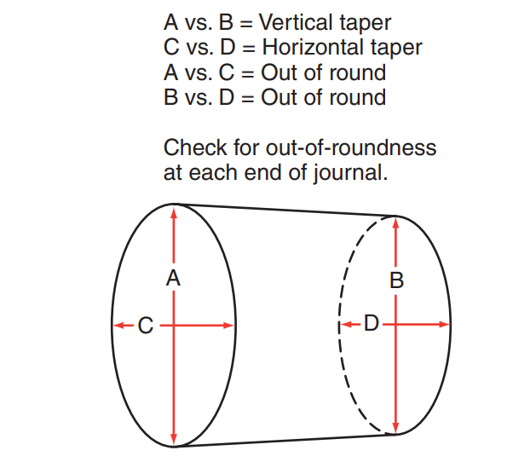
Crankshaft Inspection and Rebuilding (1 of 2)
To measure the diameter of the journals, use an outside micrometer.
Measure them for size, out-of-roundness, and taper.
Taper is measured from one side of the journals to the other.
Compare these measurements to specifications to determine if the crankshaft needs to be reground or replaced. If the journals are within specifications, the journal area needs only to be cleaned.
Check and clean the crankshaft oil passages using a small diameter bore brush
Check the sealing surface for the rear main seal. A worn or grooved seal flange can cause an oil leak.

Slide 22
Crankshaft Inspection and Rebuilding (2 of 2)
If the crankshaft is severely damaged, it should be replaced.
A crankshaft with journal taper or grooves, burnt marks, or small nicks in the journal surfaces may be reusable after the journals are refinished.
This process grinds away some of the metal on the journals to provide an even and mar-free surface. Minor journal damage may be corrected by polishing the journals with very fine sandpaper.
To check the straightness of the crankshaft, ensure that it is supported on V-blocks positioned on the end main bearing journals.
Position a dial indicator at the 3 o’clock position on the center main bearing journal. set the indicator at 0 (zero) and turn the crankshaft through one complete rotation.
The total deflection of the indicator, the amount greater than zero plus the amount less than zero, is the total indicator reading (TIR).
A special machine is used to straighten crankshafts but will only be found in serious engine rebuilding shops. In most cases, if the crankshaft is warped, it is replaced.

Slide 23
Knowledge Check (2 of 2)
Using an outside micrometer in multiple points and positions on the crankshaft journal is checking for what?

Slide 24
Knowledge Check Answer (2 of 2)
  Answer: Measuring them for size, out-of-roundness, and taper.

Slide 25
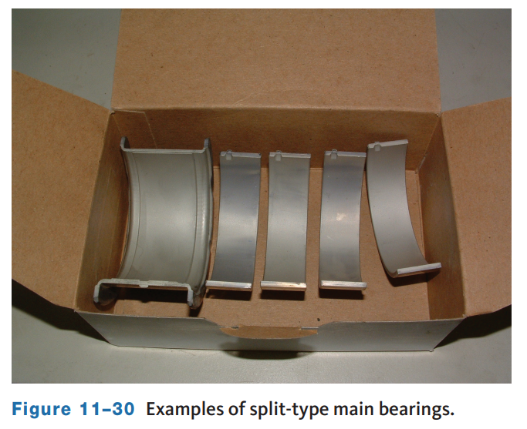
Crankshaft Bearings (1 of 2)
Bearings are a major wear item and require close inspection.
Main bearings support the crankshaft journals.
Connecting rod bearings connect the crankshaft to the connecting rods.
Crankshaft bearings are known as insert bearings.
There are two basic bearing designs. A full-round (one-piece) bearing is used in bores that allow the shaft’s journals to be inserted into the bearing, such as a camshaft.
A split (two halves) bearing is used where the bearing must be assembled around the journal.
Many crankshafts have a main bearing with flanged sides called a thrust bearing and is used to control the horizontal movement or end play of the shaft.

Slide 26
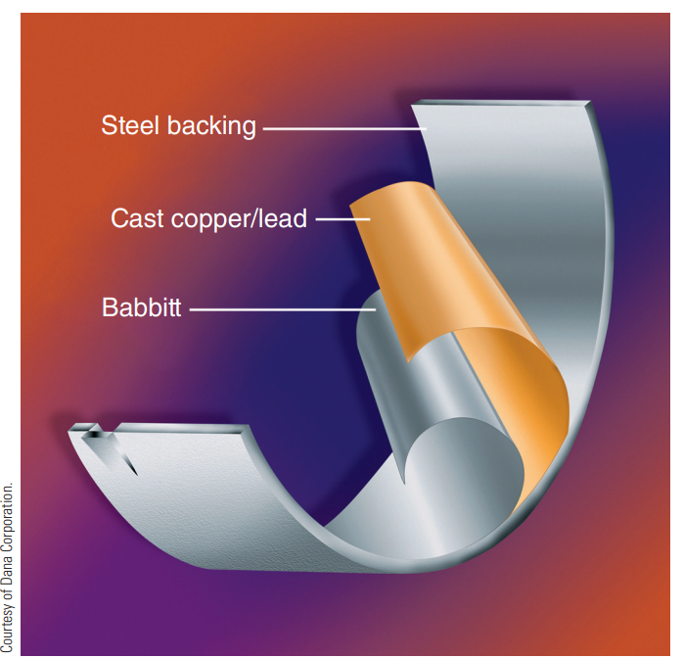
Crankshaft Bearings (2 of 2)
Bearing Materials
  Bearings can be made of aluminum, aluminum alloys, copper and lead alloys, and steel backings coated with babbitt.
  Aluminum alloy bearings are the most commonly used.
  These bearings contain silicon, which helps to reduce wear.

Slide 27
Installing Main Bearings and Crankshaft (1 of 2)
Before assembling the short block, make sure the engine is thoroughly cleaned.
A gap or clearance between the outside diameter of the crankshaft journals and the inside diameter of its bearings is necessary.
This clearance allows for the building and maintenance of an oil film.
Scored bearings, worn crankshaft, excessive cylinder wear, stuck piston rings, and worn pistons can result from too small an oil clearance.
If the oil clearance is too great, the crankshaft might pound up and down, overheat, and weld itself to the insert bearings.
During an engine rebuild, if there is little or no wear on the journals, the proper oil clearance can be restored with the installation of standard-size bearings.

Slide 28
Installing Main Bearings and Crankshaft (2 of 2)
If the crankshaft is worn to the point where standard-size bearings will leave an excessive oil clearance, a bearing with a thicker wall must be used.
Although these bearings are thicker, they are known as undersize because the journals and crankpins are smaller in diameter. In other words, they are under the standard size.
Before the bearings are installed, make sure the bore is clean and dry. Use a clean, lint-free cloth to wipe the bearing back and bore surface. Put the new main bearings into each main bearing cap and the bearing bores in the cylinder block.
The oil clearance is now measured with Plastigage.

Slide 29
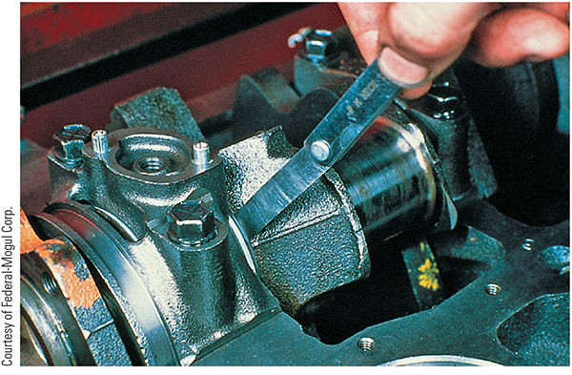
Crankshaft End Play
Crankshaft end play can be measured with a feeler gauge by prying the crankshaft rearward and measuring the clearance between the thrust bearing flange and a machined surface on the crankshaft.
You may also position a dial indicator so that the fore and aft movement of the crankshaft can be measured.
If the end play is less than or greater than the specified limits, the main bearing with the thrust surface must be exchanged for one with a thicker or thinner thrust surface.
If the engine has thrust washers or shims, thicker or thinner washers or shims must be used.

Slide 30
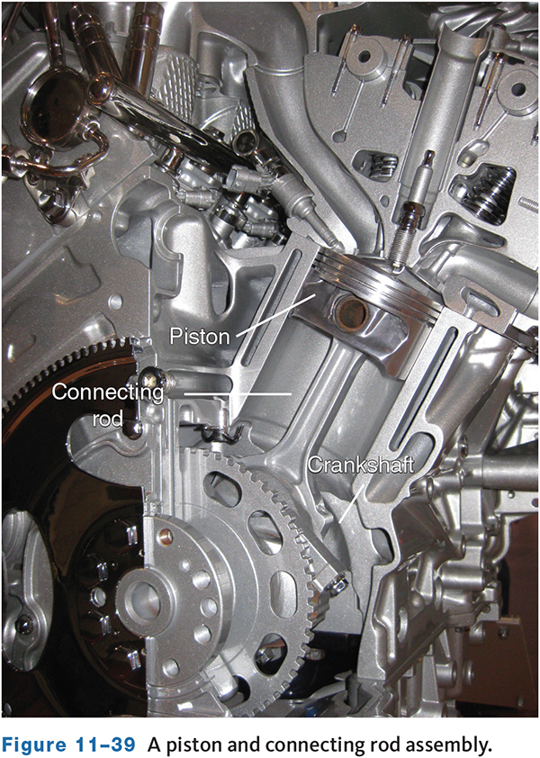
Connecting Rod
The connecting rod is used to transmit the pressure applied on the piston to the crankshaft.
The piston pin is inserted into the small end or piston pin end, which connects the piston to the rod. The piston pin can be pressed-fit in the piston and free fit in the rod.
The “big” end of the rod is attached to the crankshaft.
It is made in two pieces. The upper half is part of the rod. The lower half is called the rod cap.
The connecting rod and its cap are manufactured as a unit.
During production, the rod caps are either machined off the rod or are scribed and broken off and imperfections ensure that the cap is positioned exactly where it was before it was broken off.
The big end is fitted with bearing inserts made of the same material as the main bearings.
Many connecting rods contain a hole for oiling the bearing area.

Slide 31
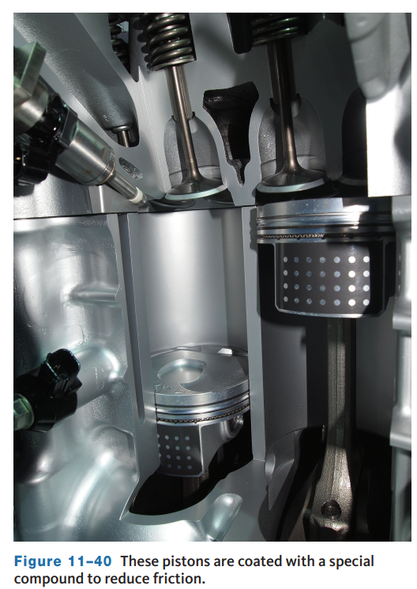
Piston and Piston Rings (1 of 3)
11.06 Be able to perform the common service and assembly techniques used in connecting rod and piston servicing.
The pressures from combustion are exerted against the top of the piston, called the head or dome.
A piston must be strong enough to face this pressure; however, it should also be as light as possible.
There are three basic types of aluminum silicon alloys used in pistons: hypoeutectic, eutectic, and hypereutectic. Late-model engines that are capable of running to fairly high rpm use pistons that have skirts only on the thrust sides and often have special patches or coatings to reduce friction and wear.
The head of the piston can be flat, concave, convex, crowned, raised and relieved for valves, or notched for valves.

Slide 32
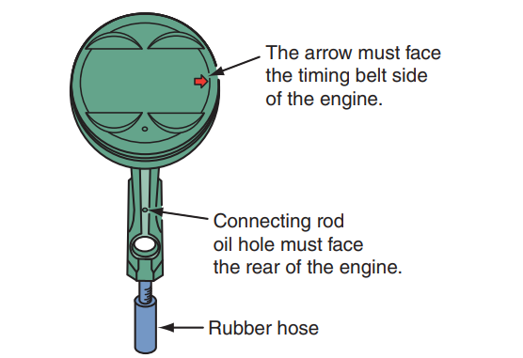
Piston and Piston Rings (2 of 3)
Just below the dome, around the sides of the piston, are grooves which are used to hold the piston rings. The areas between the grooves are called ring lands.
Some pistons have a ceramic coating in the top ring groove to prevent the ring from being “welded” inside the groove.
Normally, there are two compression and one oil control groove.
The compression grooves are located toward the top of the piston.
The oil control groove is the lowest groove on the piston and has holes or slots to allow oil to drain.
The area below the piston pin is called the piston skirt. The area below the bottom ring groove and the tip of the skirt is the piston thrust surface.

Slide 33
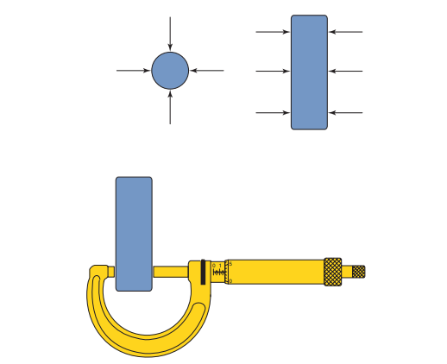
Piston and Piston Rings (3 of 3)
Piston pins are basically thick-walled hollow tubes. Most are made from alloy steel and are plated with chrome, carburized, and/or heat-treated to provide good wear resistance.
Piston pins are lubricated by oil fed through passages in the connecting rods, oil splashing in the crankcase, or spray nozzles in the rods or pistons.
A piston pin fits through the connecting rod and the piston’s pin bore.
Inspect the pin boss area on the piston for signs of pin wobble. Then remove the pin to inspect it. With full-floating pins, the retaining clips are removed and the pin pushed out.

Slide 34
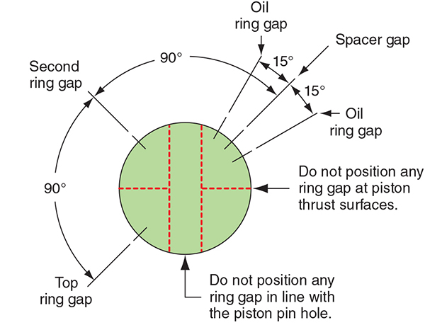
Installing Pistons and Connecting Rods
Before installing the piston and connecting rod assemblies, snap the bearing inserts into the connecting rods and rod caps.
Make sure the tang on the bearing fits snugly into the matching notch.
Check the clearance of the connecting rod bearings with Plastigage or a micrometer.
Make sure that the end gaps of the piston rings are staggered prior to installing the piston assembly.
Coat the crankshaft with clean lubricant or engine oil.
After each piston is installed, rotate the crankshaft and check its freedom of movement.

Slide 35
Timing Components
11.09 Install crankshaft and camshaft timing components and verify correct timing.
The timing belt or chain and crankshaft/camshaft gears (sprockets) should be inspected and replaced if damaged or worn.
A timing gear with cracks, spalling, or excessive tooth wear is an indication of improper backlash (either insufficient or excessive). Excess backlash causes accelerated tooth wear and breakage.
Insufficient backlash can cause the gears to bind, which can cause spalling and wear. Gear backlash is checked with a dial indicator. Check the movement between the camshaft and crankshaft gears at six equally spaced teeth. Firmly hold the gear against the block while making the check. Refer to specifications for backlash limits.

Slide 36
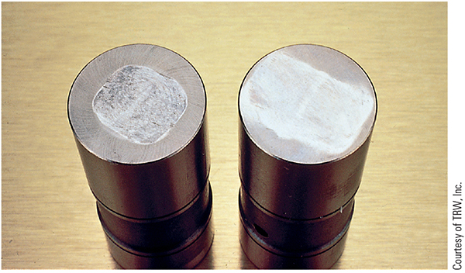
Lifters
Lifters: When inspecting lifters, carefully check their bottoms and pushrod sockets.
Bottom wear should be off the center on the lobe and with no signs of edge contact.
If they show abnormal wear, scoring, or pitting, they should be replaced.
Any lifter that has its contact face worn flat or concave must also be replaced.

Slide 37
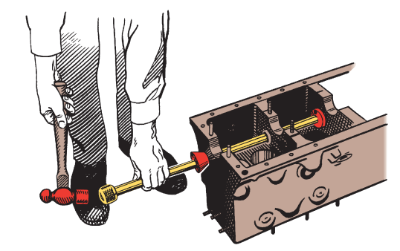
Camshaft Bearings
11.08 Inspect and install an OHV camshaft and bearings.
The bearings are either aluminum or steel with a lining of babbitt which is a soft slippery material made of mostly lead and tin.
OHV cam bearings are one piece, often called full-round bearings, and are press-fit into the block using a bushing driver and hammer.
Wipe each cam bearing with a lint-free cloth, then thoroughly coat the camshaft lobes and bearing journals with assembly lube.
Once all of the camshaft bearings have been installed, it is important to make sure that the holes in the bearings are properly aligned with the oiling holes in the cylinder block.

Slide 38
Camshaft
Install the camshaft, taking care not to damage the bearings with the edge of a cam lobe or journal, and keep it straight while installing it.
A threaded bolt in the front of the camshaft helps guide the cam in place.
When the camshaft is in place, install the thrust plate and the timing gear.
Align the thrust plate with the woodruff key. Never hammer a gear or sprocket onto the shaft.
Heating steel gears helps with installation, but do not heat fiber gears. When installing the gears, keep the gear square and aligned with the keyway at all times. Once the shaft is in the block, it should be able to be turned by hand. If it does not turn, check for a damaged bearing, a nick on a cam’s journal, or a slight misalignment of the block journals.
Lubricate the valve lifters before installing them in their bores. Most cam wear happens within the first few minutes of operation.

Slide 39
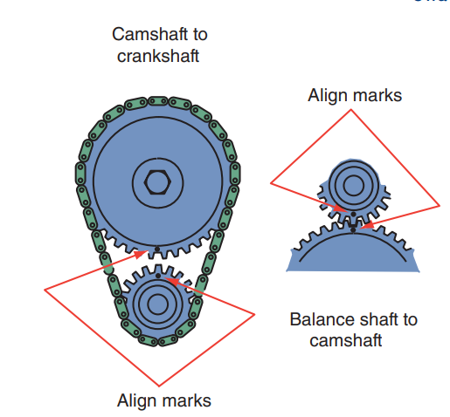
Crankshaft and Camshaft Timing
During most engine rebuilds, a completely new timing assembly is installed.
The camshaft drive must be installed so that the camshaft and crankshaft are in time with each other. Both sprockets are held in position by a key or possibly a pin.
There are factory timing marks on the crankshaft and camshaft gears or sprockets.
Carefully place the entire assembly, as a unit, onto the shafts by evenly pressing both gears while keeping the keyways aligned.
Then gently tap them in place.

Slide 40
Balance Shafts
Each bearing and journal should be cleaned and carefully inspected. All worn or damaged parts should be replaced.
The oil clearance between the shafts and bearings should be checked with Plastigage.
To install the balance shaft assembly, install the bearings in the crankcase and housing. Apply a light coat of engine oil on the bearings.
The shafts must be properly timed to the crankshaft. On some engines, there are two balance shafts; these must be timed to each other, in addition to the crankshaft.
Align the timing marks of the balance shaft(s). Set the shaft(s) into position in the block. Place the housing with bearings over the shafts.
Install and tighten the housing bolts, according to specifications.

Slide 41
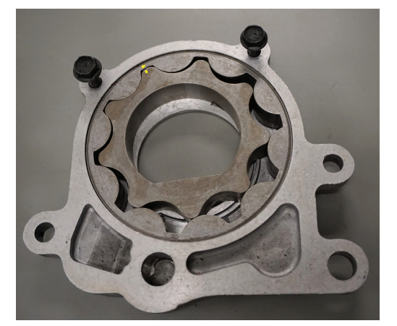
Oil Pump Service (1 of 2)
11.10 Inspect, service, and install an oil pump.
The oil pump should be carefully inspected.
Once all parts have been removed, clean them and dry them off with compressed air. Inspect the pump gears or rotors for chipping, galling, pitting, or signs of abnormal wear.
Examine the housing bores for similar signs of ear. If any part of the housing is scored or noticeably worn, replace the pump assembly.

Slide 42
Oil Pump Service (2 of 2)
Check the mating surface for the pump cover for wear. If the cover is excessively worn, scored, or scratched, replace the pump.
Use a feeler gauge and straightedge to check its flatness. There are specifications for acceptable warpage. If the cover is excessively warped, replace the pump.
With gear-type pumps, reinstall the gears into the pump body. Use a feeler gauge to check the clearance between the outer gear and the pump body. If the housing-to-gear clearance exceeds specifications, replace the oil pump.
Use a micrometer to measure the diameter and thickness of the rotors.
Position the inner and outer rotor lobes so that they face each other. Measure the clearance between them with a feeler.

Slide 43
Discussion
Engine lower end inspection and reassembly include many steps.
Have a class discussion about how you would ensure that you do not miss a step or a procedure when reassembling the lower end, and what would happen if you did miss the step or procedure.

Slide 44
Chapter Reflection
Please take a moment to compare your perception of the automotive industry before and after you studied this chapter. Then respond to the following questions in one or two paragraphs. Use 150–200 words in your reflection.
Did anything in this chapter change your thinking about engine lower end inspection and reassembly.
Considering all you have learned, do you feel you prepared to perform the lower end service, if not what will you do to prepare yourself?

